Slide 1
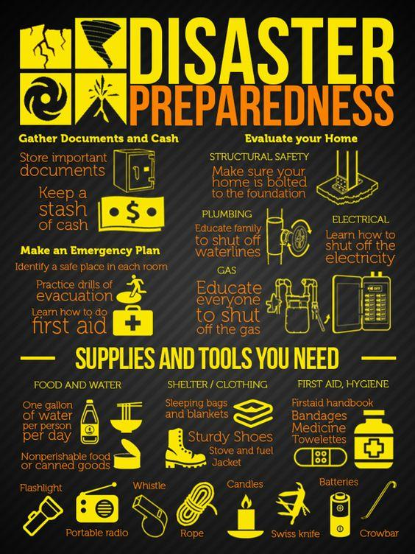
Disaster recovery with IBM cloud virtual servers
This Photo by Unknown author is licensed under CC BY-SA-NC.

Slide 2
PROBLEM DEFINITION
The project involves creating a disaster recovery plan using IBM cloud virtual servers to ensure business continuity in the face of unforeseen events.
The primary objective is to safeguard business operations by developing a comprehensive plan that guarantees minimal down me for an on premises virtual machine

Slide 3
DESIGN THINKINGS
Disaster recovery strategy:
Backup configuration:
Replication setup:
Recovery testing:
Business continuity

Slide 4
1.DISASTER RECOVERY STRATEGY
OBJECTIVE
Ensure business continuity in the face of the disasters
KEY ELEMENTS
Risk assessment
Business impact analysis
RTOS/RPOS
Automated recovery

Slide 5
2.BACKUP CONFIGURATION
OBJECTIVE
Create reliable data backups for recovery
KEY ELEMENTS
Data identification
Backup storage
Backup methods
Backup software

Slide 6
3.REPLICATION SETUP
OBJECTIVE :
Maintain real time or near real time copies of critical system
KEY ELEMENTS :
Replication technology
Secondary site
Network connectivity
Data selection

Slide 7
4.RECOVERY TESTING
OBJECTIVE :
Validate recovery procedures and scripts
KEY ELEMENTS :
Test scenarios
Test environment
Documentation
Execution

Slide 8
5.BUSINESS CONTINUITY
OBJECTIVE :
Ensure critical operations continue during and after a disaster
KEY ELEMENTS :
Communication
User training
Compliance
Security measures

Slide 9
AUTOMATED RECOVERY SCRIPTS :
In this face of disasters or critical system failures our organization encounters significant operational disruptions and prolonged downtime

Slide 10
KEY COMPONENTS OF THE PROBLEM DEFINITION :
Nature of the problem :
Consequences :
Current state :
Scope :
Dependencies :
Requirement :
Stakeholders :
Regulatory consideration :

Slide 11
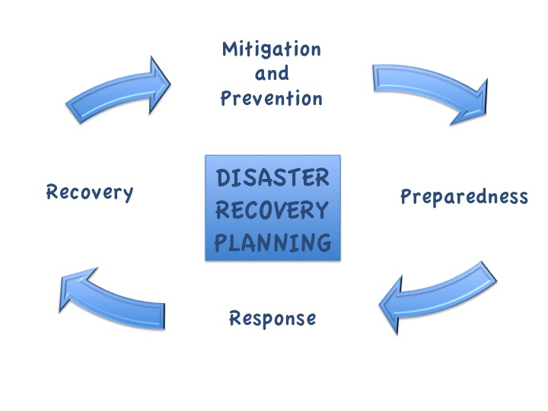
PROJRCT WORK FLOW :
DISASTER RECOVERY PLAN :
Recovery team assessment :
Activate disaster recovery plan :
Identify disaster recovery scripts
Open incident report :
Open change control request :
Execute disaster recovery scripts
This Photo by Unknown author is licensed under CC BY-SA.

Slide 12
PROACTRIVE MONITORING
Infrastructure monitoring
Application monitoring
Security monitoring
Log and event monitoring
Business continuity monitoring
Alerting and incident response
Automation
Geographical redundancy

Slide 13

This Photo by Unknown author is licensed under CC BY-NC.

